Slide 1
TERM 2:WEEK 2
ENERGY FLOW AND CHEMICAL CHANGE

Slide 2
SPONTANEOUS CHEMICAL REACTIONS
Spontaneous chemical reactions are reactions that occur at room temperature without the input of energy such as heat or electricity.
Metals can react spontaneously. All metals have relatively high melting points, however, they do not have identical melting points. They have similar chemical properties, but they are not identical.

Slide 3
Some metals react spontaneously with water, acid and oxygen. The generalised equations for these reactions are:
Metal + water➔ metal hydroxide+ hydrogen
Metal+ acid ➔ a salt+ hydrogen
Metal + oxygen ➔ metal oxide

Slide 4
REPRESENTING CHEMICAL REACTIONS
Balanced chemical equations give general information about the reactants and the products. However, ionic equations give information about each species present in the reaction.
The species that change are the ones that are taking part in the reaction. The species that are the same on both sides of the ionic equation are called spectator ions. They are present but they do not take part in the chemical reaction.
Net ionic equations only show the species that are taking part in the chemical reaction; spectator ions are not included.

Slide 5
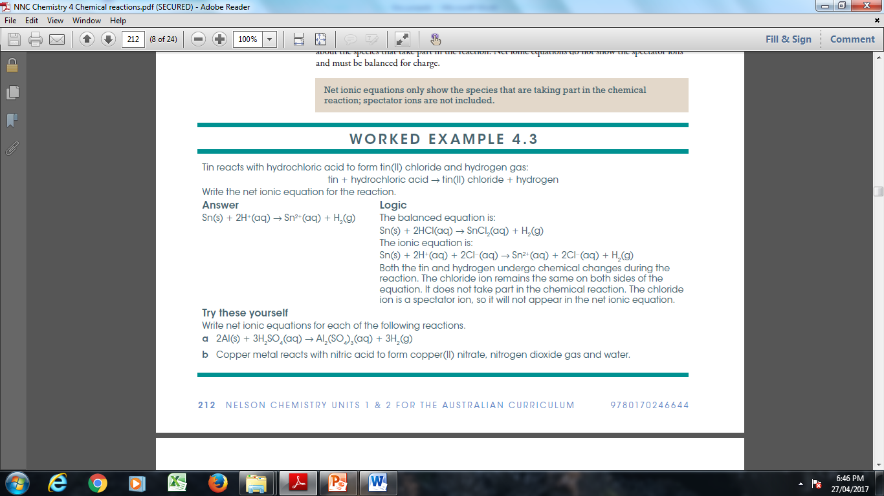

Slide 6
UNDERSTANDING ENERGY
Energy can be described as the capacity to do work or cause change. It is measured in joules.
If the energy present in a given system falls then there will be a corresponding rise in the energy of its surroundings so that the total energy in the system + surroundings remains constant.
This idea is known as the law of conservation of energy.

Slide 7
ENERGY CHANGES IN CHEMICAL REACTIONS
The enthalpy of a substance is the total energy present in the substance. It includes the energy stored in chemical bonds, known as chemical potential energy plus the energy due to particle motion, ie, the kinetic energy of the particles. Chemical potential energy of a bond is high for a weak bond and low for a strong bond.
The temperature of the reaction system will rise or fall and cause heat energy to flow into or out of the reaction system. Heat always flows from hot regions to cooler ones. This flow of heat changes the enthalpy of the reaction system.

Slide 8
Delta H = H( products) - H ( reactants)
Where H – enthalpy, Delta H - change in enthalpy
Delta H can also be referred to as heat of reaction.

Slide 9
ENDOTHERMIC $ EXOTHERMIC REACTIONS
Reactions that lose heat to the surroundings are called as exothermic reactions. In this case a negative value for delta H. This means enthalpy decreases during the course of the reaction.
Reactions that gain heat from the surroundings are called endothermic reactions. These reactions have a positive value for delta H, means enthalpy increases during the course of the reaction.
This will happen when some of the particle kinetic energy in the reaction system is converted into chemical potential energy stored in bonds. Overall, no change in enthalpy. However, as a consequence of the reduced particle kinetic energy the reacting system's temperature will fall. Heat then flows from warmer surroundings into cooler reacting system. This increases the reacting system’s total energy and hence delta H is positive.

Slide 10
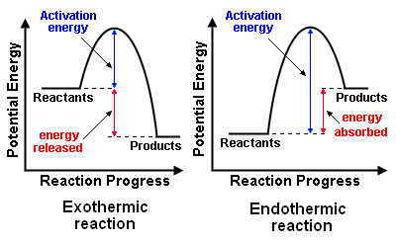
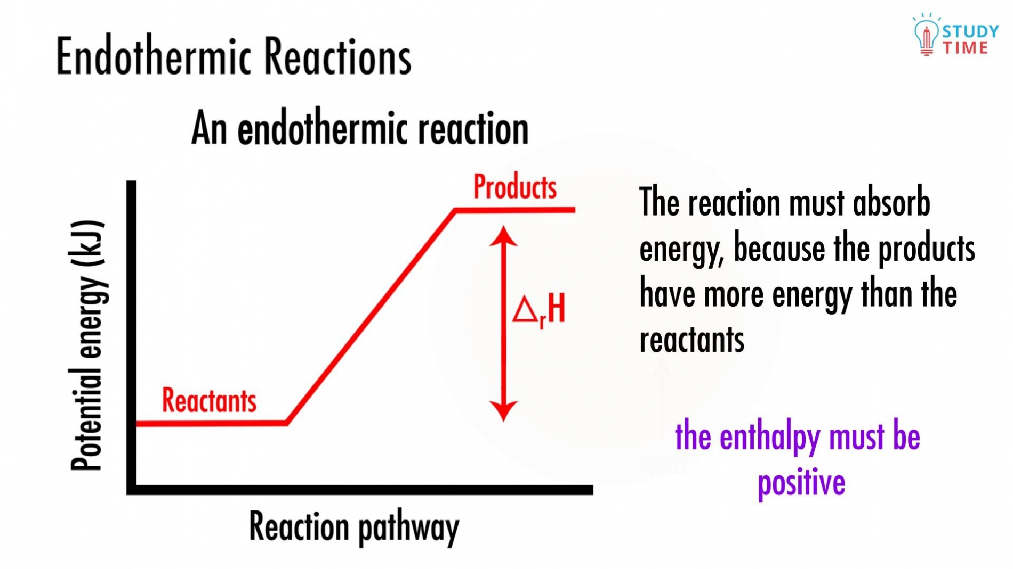
REPRESENTING ENERGY CHANGES IN CHEMICAL REACTIONS
Using an energy profile diagram the enthalpy change, delta H for a chemical reaction can be represented graphically or it can be written along with the chemical equation.

Slide 11
Look at the equations in 13.4 from page: 102: Essential chemistry Unit 1&2

Slide 12
ENERGY EFFECTS OF MAKING AND BREAKING BONDS
Bond breaking requires an input of energy, ie, endothermic ( raises enthalpy).
Stronger the bonds to be broken the more energy that needs to be absorbed o achieve this.
Bond making releases energy, ie, exothermic ( lowers enthalpy)
Stronger the bonds that are formed the greater is the energy released in forming them.

Slide 13
The sublimation of solid iodine, I2 (s) to form iodine vapour, I2 (g) is endothermic as it involves breaking of bonds.
The weak intermolecular forces ( IMFs) between neighbouring iodine molecules in the solid phase are broken to form unbonded iodine molecules in the gas phase.
The reverse reaction involves the formation of bonds ( weak IMFs) between iodine molecules is an exothermic reaction.
I2 ( s) + 62kJ → I2 ( g) (1) I2 ( g) → I2 ( s) + 62kJ (2)

Slide 14
Write thermochemical equations for the following reaction.
Magnesium reacts with oxygen to form magnesium oxide. This is an exothermic reaction during which 1202 kJ is released.

Slide 15
TEMPERATURE SCALES
In Australia, temperature is commonly reported in degree Celsius
(^{O} C).
Scientists often use absolute temperature scale, which is measured in kelvin (K).The linear relationship between the Celsius temperature scale and the absolute temperature scale:
Temperature (^{O} C) = Temperature (K) -273
Convert the following temperatures from ^{O} C to K.
a) 25 ^{O} C b) -4 ^{O} C

Slide 16
SPECIFIC HEAT CAPACITY
Each substance has a different ability to hold heat.
When chemists compare the capacity of different substances to hold heat in Chemistry, t hey use a standard unit of measure called the specific heat capacity. It is the heat needed to increase the temperature of 1g of the substance by1K.
Values can be compared because the mass of the substance and the increase in temperature are the same.
The only variable is the material’s capacity to hold heat.

Slide 17
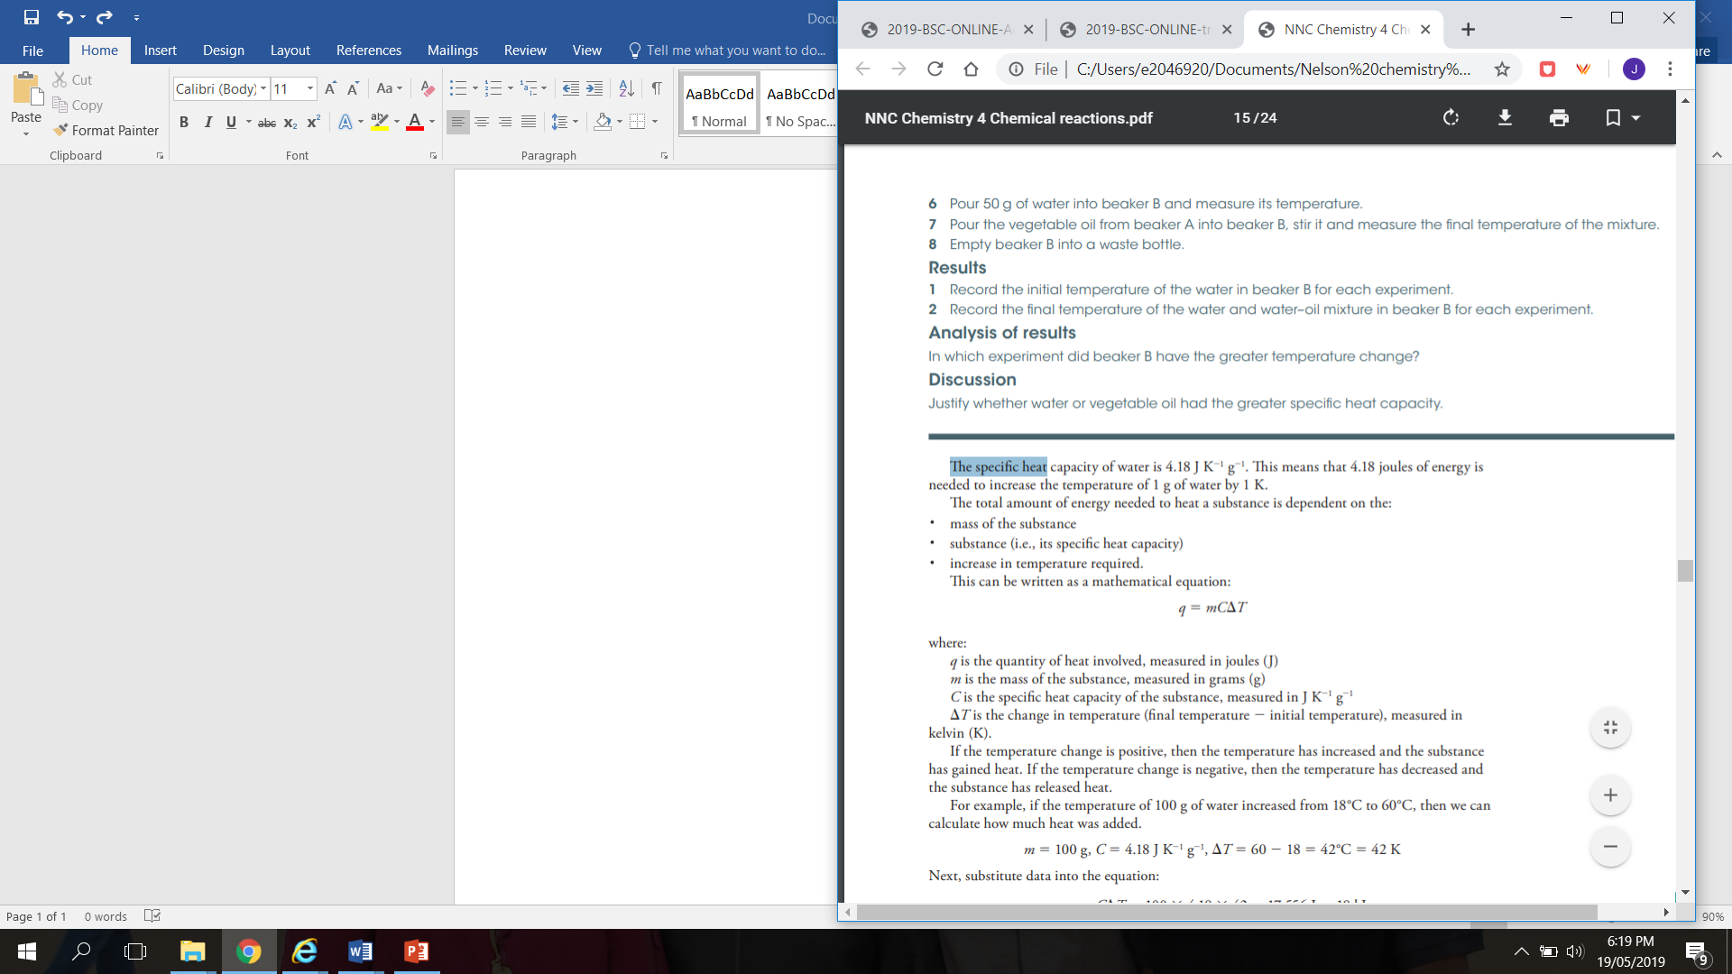

Slide 18
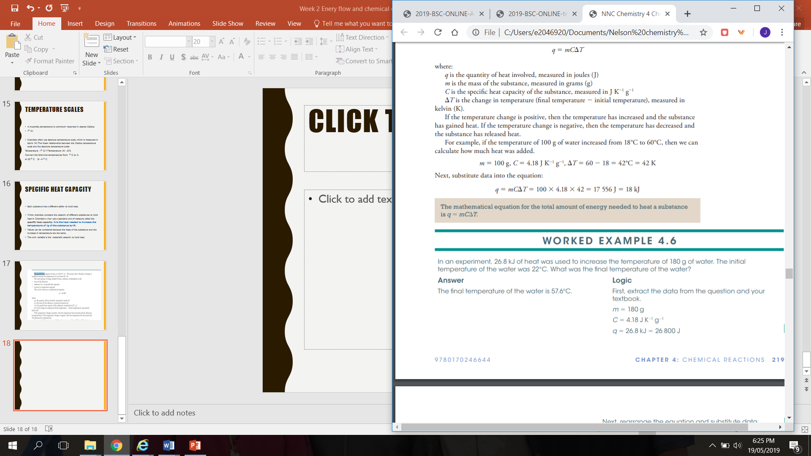

Slide 19
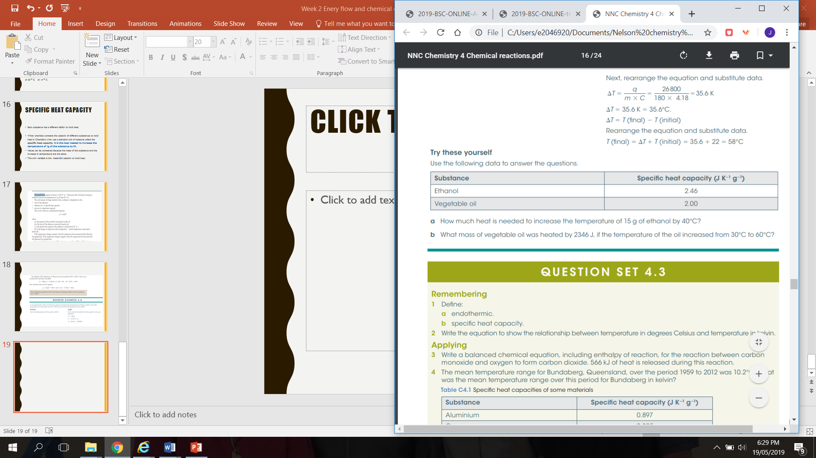

Slide 20
https://www.youtube.com/watch?v=DWNsZfyFLr4

Slide 21
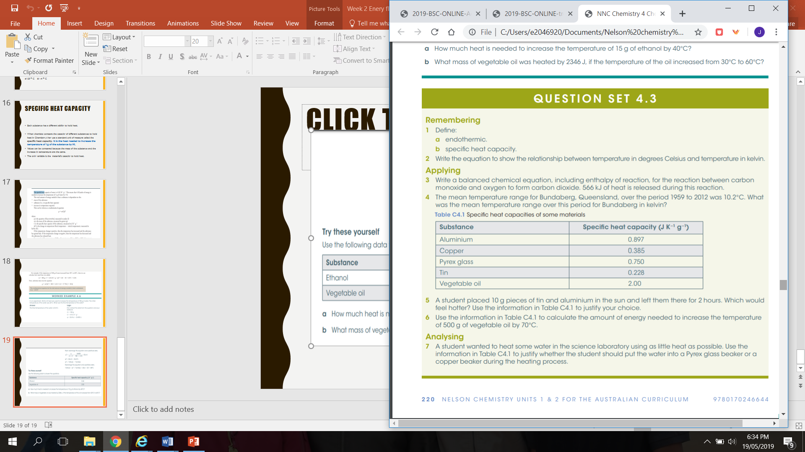

Slide 22
COMBUSTION REACTIONS
Combustion reactions are reactions where substances are burnet in the presence of oxygen and release large amounts of energy. E.g. Burning of fuels
General equation used for respiration is a combustion reaction that occurs in our body cells.
Glucose and oxygen react to produce carbon dioxide and water.
C6 H12 O6 + O2 ( g) → CO ( g) + H2O (l)

Slide 23
Complete combustion occurs when fuels react with oxygen at standard atmospheric pressure to produce carbon dioxide and water ie, the oxides of carbon and hydrogen are produced.
When incomplete combustion occurs carbon monoxide or carbon and water are the products produced. When there is not enough oxygen incomplete combustion occurs.

Slide 24
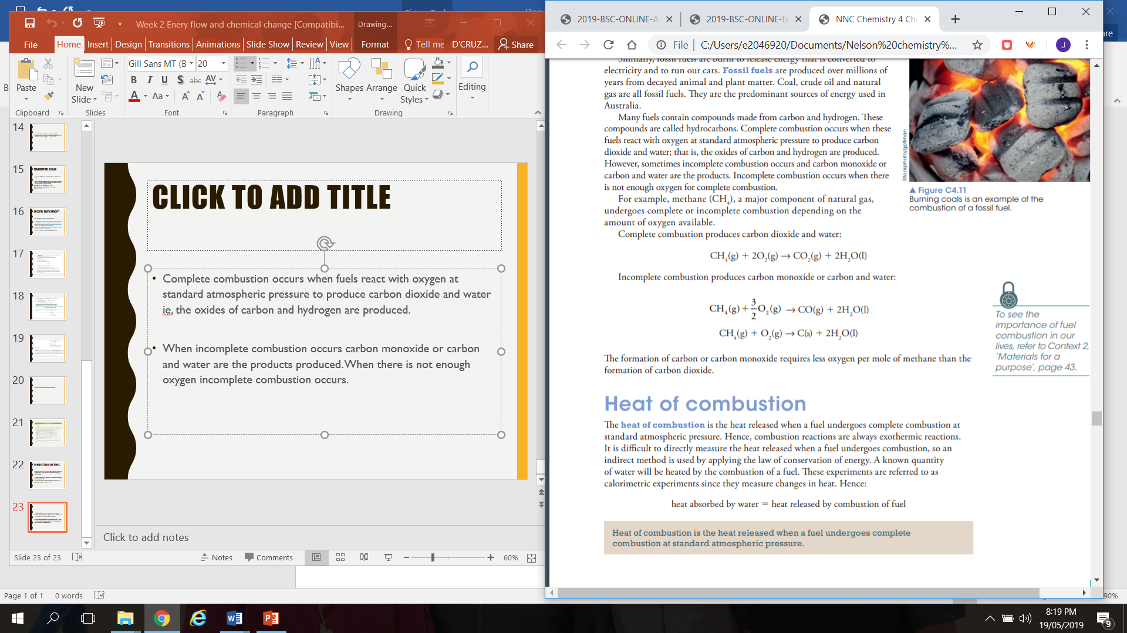

Slide 25
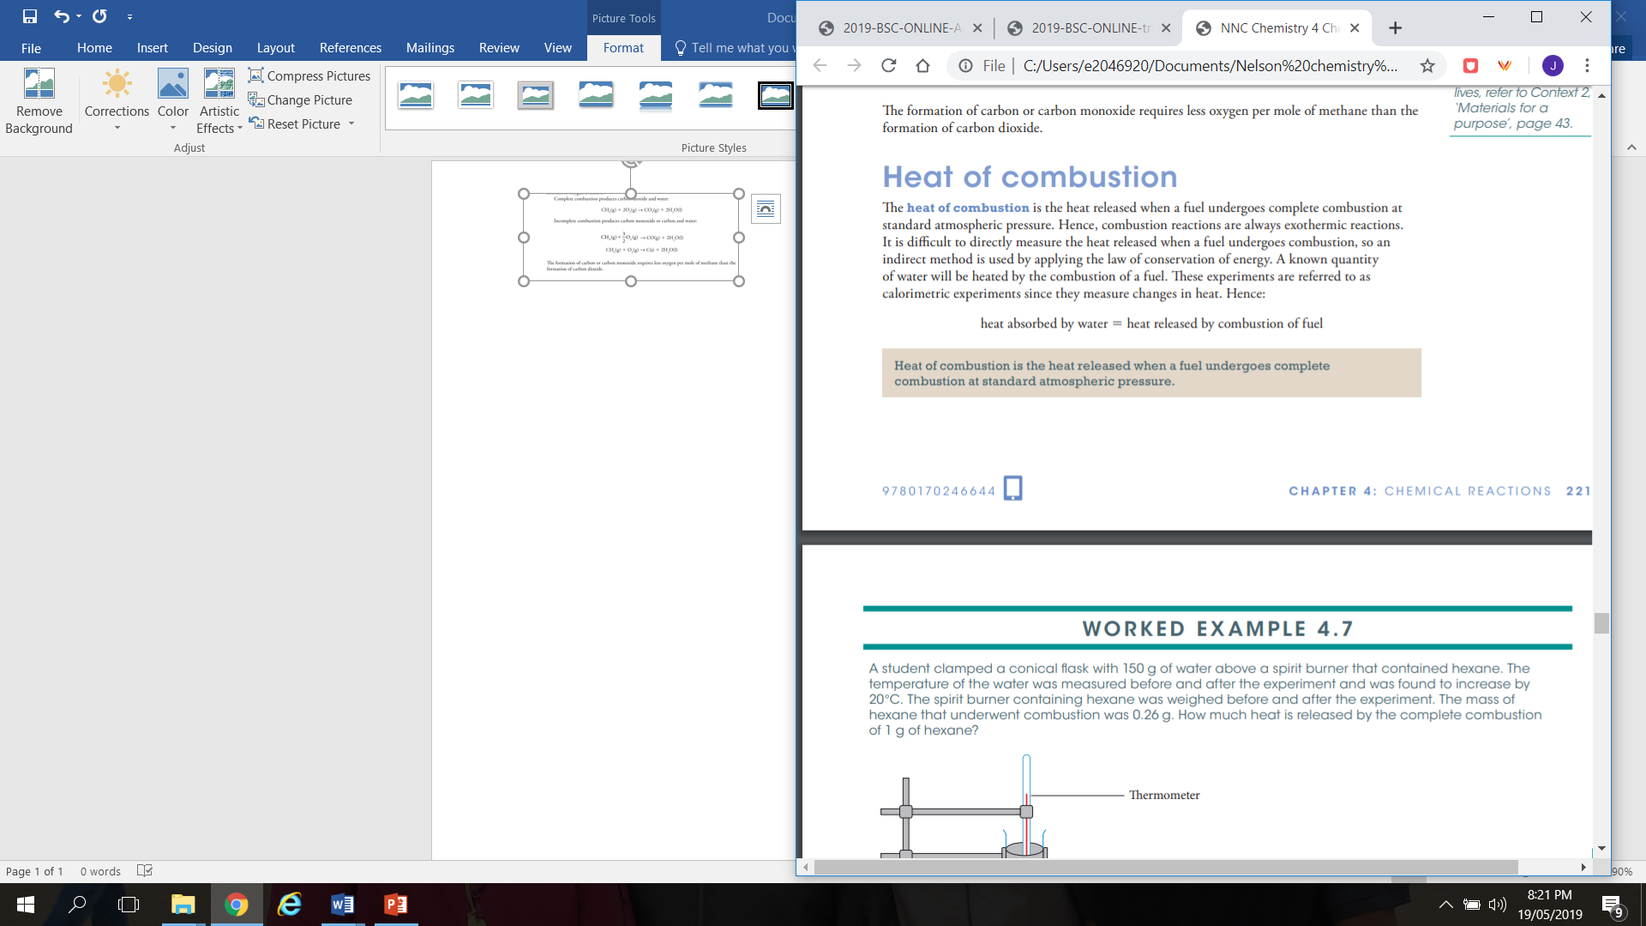

Slide 26
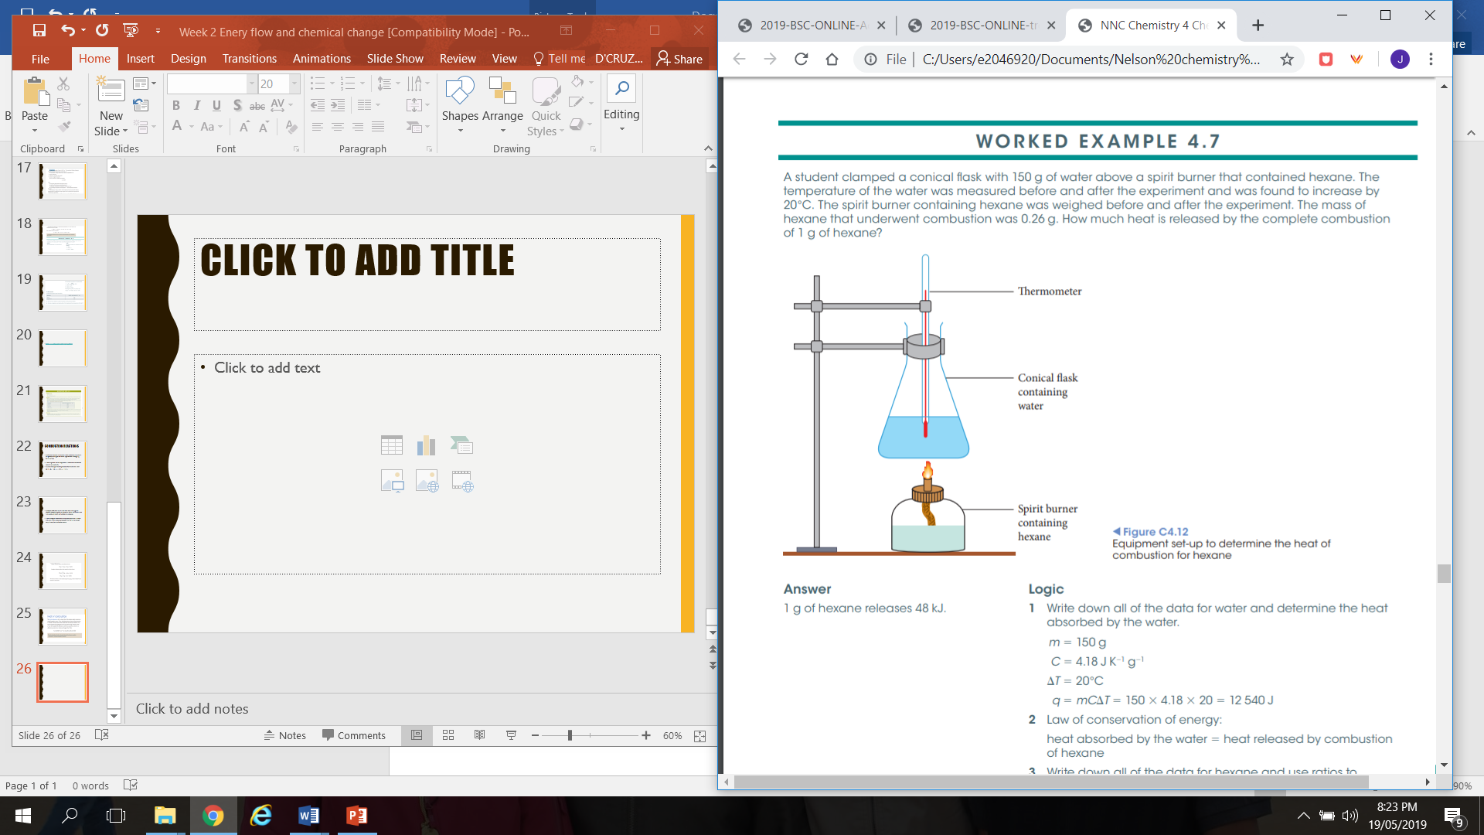

Slide 27
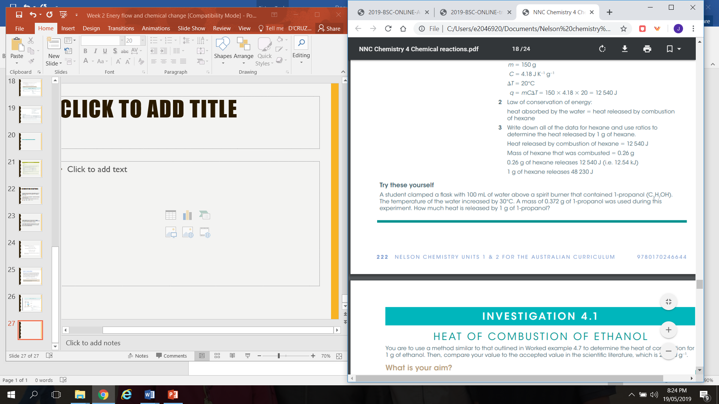

Slide 28


